Slide 1
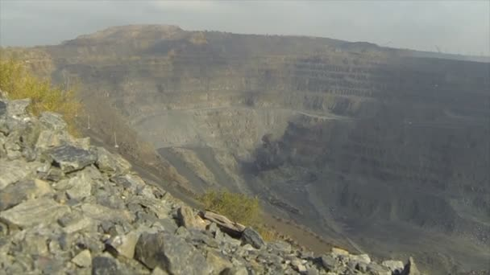
AI Mineral Discovery
Searching for Mineral Deposits Using Deep Learning and Satellite Imagery

Slide 2
Findings
We set a threshold of 60% accuracy as our baseline for determining if this idea was worth pursuing.
Greater than 60% accuracy was achieved on two different types of minerals, so we decided to pursue this idea further.
Therefore, it appears that a CNN is able to detect patterns in satellite images that correspond to the presence of a given mineral and that this idea warrants further investigation.

Slide 3
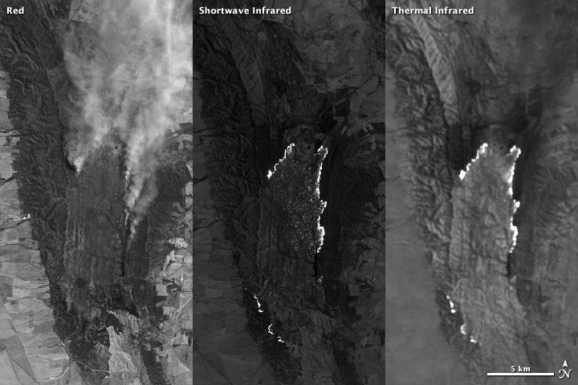
Introduction
The inspiration for this project came from this paper: https://agupubs.onlinelibrary.wiley.com/doi/epdf/10.1002/2016GC006501 where satellite imagery is used to detect the presence of minerals by searching for their surface reflectance signature contained in light bands of the image.
So, can a CNN pick out the terrain features or light signatures that indicate the presence a particular mineral?

Slide 4
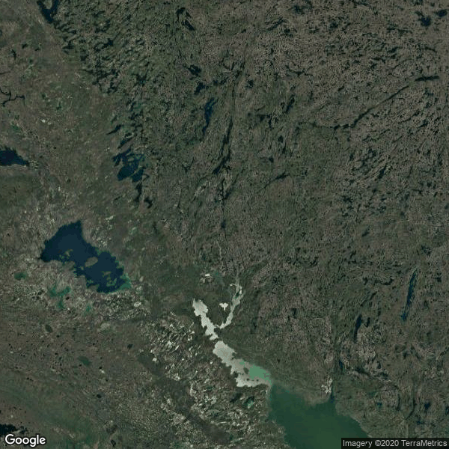
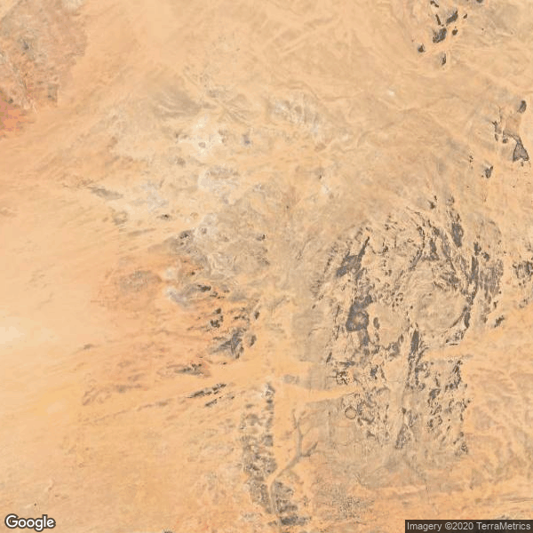
Data Collection / Methodology
Data sourcing - the lat/long coordinates of known mineral deposits were obtained from a USGS dataset: Rare earth element mines, deposits, and occurrences - Data.gov A Python program was written to fetch the corresponding terrain image for each of the sets of coordinates. Each image was labeled as a site either containing the desired mineral or not containing it.
Mineral present
Mineral not present

Slide 5
Model Training
The database of coordinates was used to fetch an image of the location from Google Maps API.
The images were then resized and stored according to what mineral they contained, or did not contain.
2-Layer CNN was used with a 3x3 kernel for each layer.
The Adam optimizer was selected for speed.

Slide 6
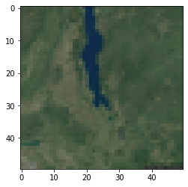
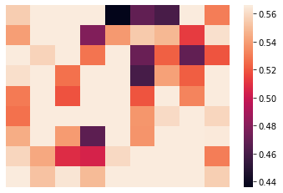
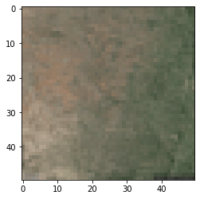
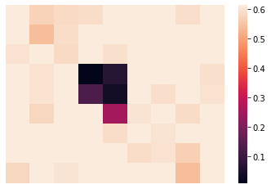
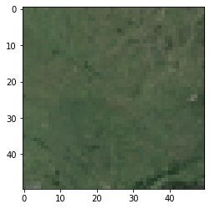
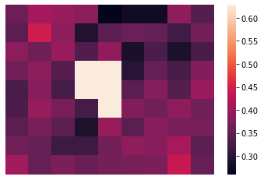
Results
Quartz - average of 66.5% (+/- 1.5%) accuracy was achieved. Magnetite - an average 71.5% (+/- 9.71%) accuracy was achieved.
By occluding parts of the image, we can show which neurons were the highest activated (darkest color) when the model was making its predictions.

Slide 7
Follow up:
Experimentation must be done in order to increase the accuracy of the model predictions.
This can include increasing the size of the images, adjusting learning parameters, and using alternate optimizer algorithms.

